Slide 1
Data Mining DS-303
Lecture 2
Muhammad Arham
Lecturer
The University of Faisalabad

Slide 2
Content
Data Mining Process & Basic Concepts

Slide 3
Data Mining Process

Slide 4
Process of Data Mining
Data Mining is essentially a Process of data-driven extraction of not-so-obvious but useful information from large databases.
The entire process is interactive and iterative

Slide 5
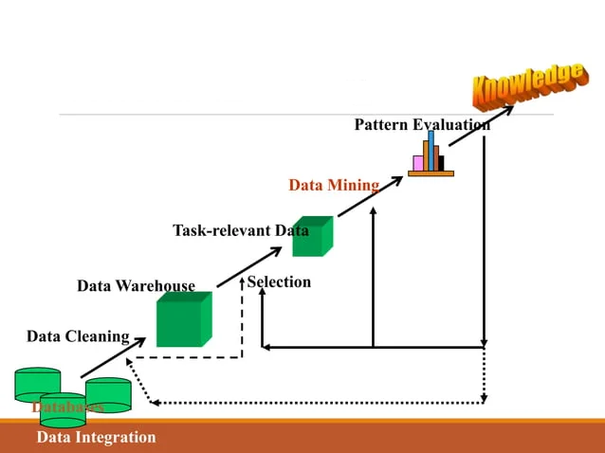
Process of Data Mining

Slide 6
Data Cleaning
Real-world data tends to be incomplete, noisy, and inconsistent.
Incomplete: lacking attribute values, lacking certain attributes of interest.
E.g, occupation= “ ” (missing data)
Noisy: containing noise, error, or outliers
E.g, salary= “-10” (an error)
Inconsistent: containing differences in codes or names,
E.g, age= “42” birthday = “03/07/1997”

Slide 7
Data Integration
Data integration is the merging of data from multiple sources.
These sources may include multiple databases, data cubes, or flat files.

Slide 8
Data Selection
Where data relevant to the analysis task are retrieved from the databases. Therefore, irrelevant, weakly relevant, or redundant attributes may be detected and removed .

Slide 9
Data Transformation
Where data are transformed or consolidated into forms appropriate for mining by performing:
Summary or aggregation operation, for example:
Daily sales may be aggregated to monthly sales or annual sales.
Generalization, for example:
City may be generalized to country, or age may be generalized to young, middle-aged, senior.

Slide 10
Data Mining
An essential process where intelligent methods are applied on data to covert it to knowledge in for decision making.
A wide range of methods can be used in data mining, such as neural nets, decision tree and association.

Slide 11
Pattern Evaluation
To identify the truly interesting pattern bases on some interestingness measures.
A pattern is considered interesting if it is:
Valid
Novel
Actionable
Understandable

Slide 12
Knowledge Representation
Knowledge presentation is the framework that converts a large amount of data into a particular data or procedure that a human being can figure out based on an intention.
In knowledge representation, visualization tools and knowledge representation techniques are used to present the mined knowledge to the user.

Slide 13
Basic Concepts

Slide 14
Data, Information & knowledge
Data
The most elementary description of things, events, activities, and transactions.
Information
Organized data that has meaning and value.
Knowledge
The concept of understanding information based on recognized patterns in a way that provides insight to information

Slide 15
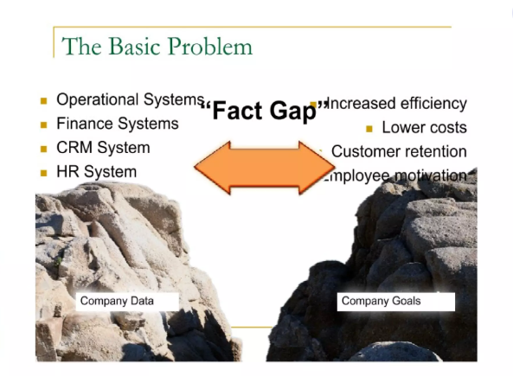

Slide 16
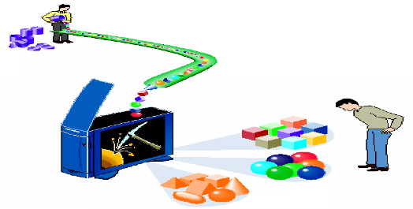
What is data mining?
Data mining: the task of discovering interesting patterns from large amounts of data

Slide 17
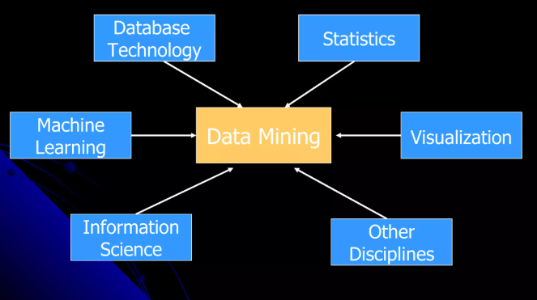
Data Mining: Confluence of Multiple Discipline

